Slide 1
Publishing options: FINELIB institute associated corresponding authors

Slide 2
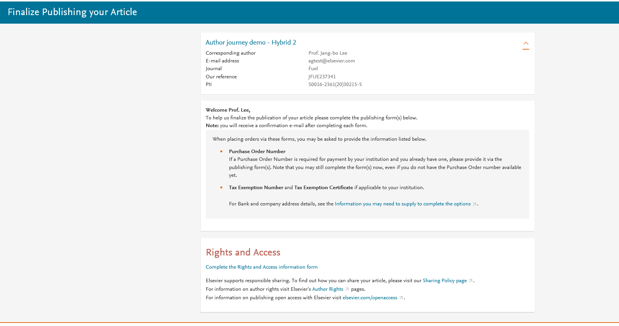
Corresponding author receives an email post acceptance with a link an unique link to complete the author journey and choose publishing options
Author clicks on Complete the Rights and Access information form

Slide 3
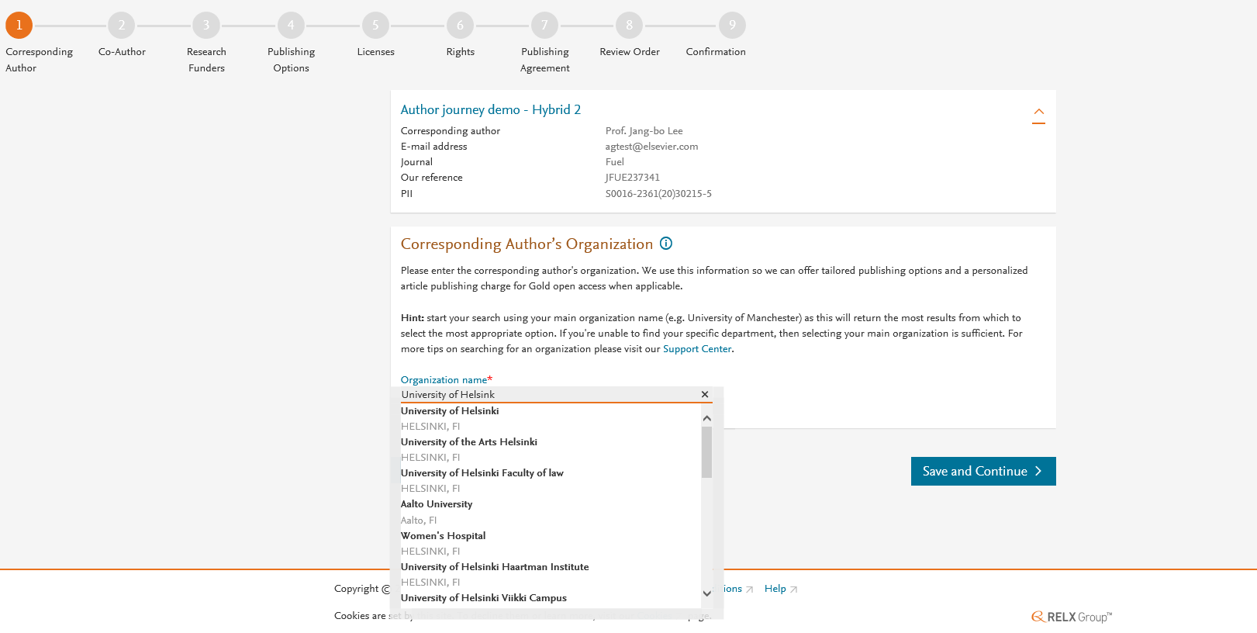
Corresponding author selects his/her affiliation details which we use to identify the authors and match them to the FINELIB agreement

Slide 4
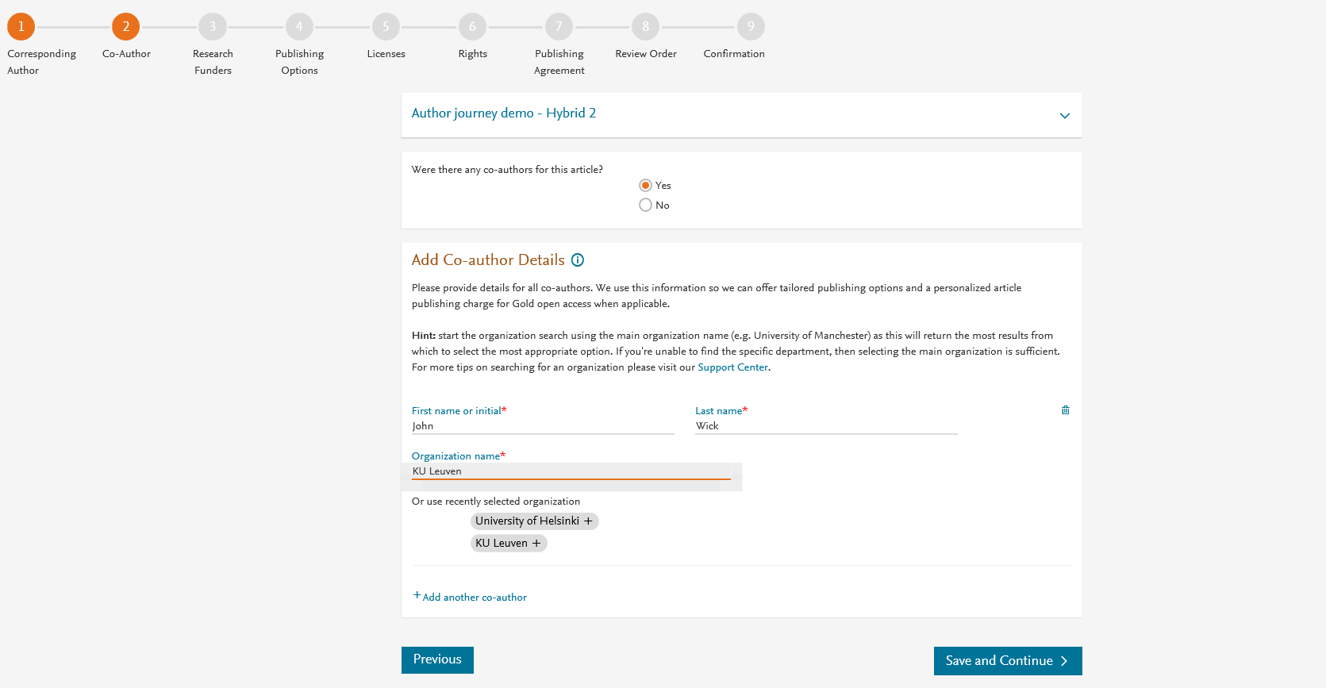
Corresponding author also adds the co-author affiliation details

Slide 5
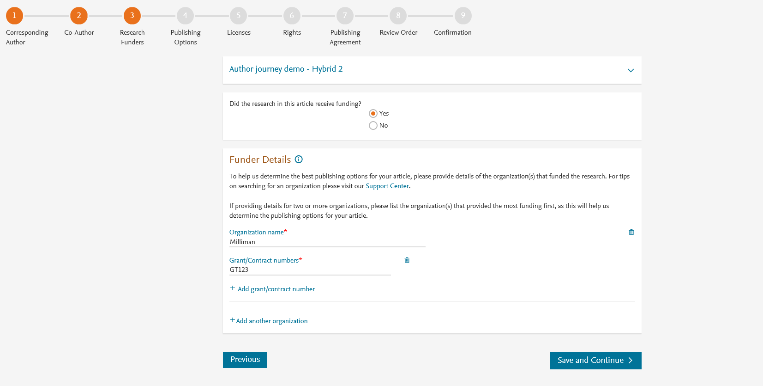
Author can add the Funder details. Funder can be the affiliated institute or a different one. In this case it is Milliman

Slide 6
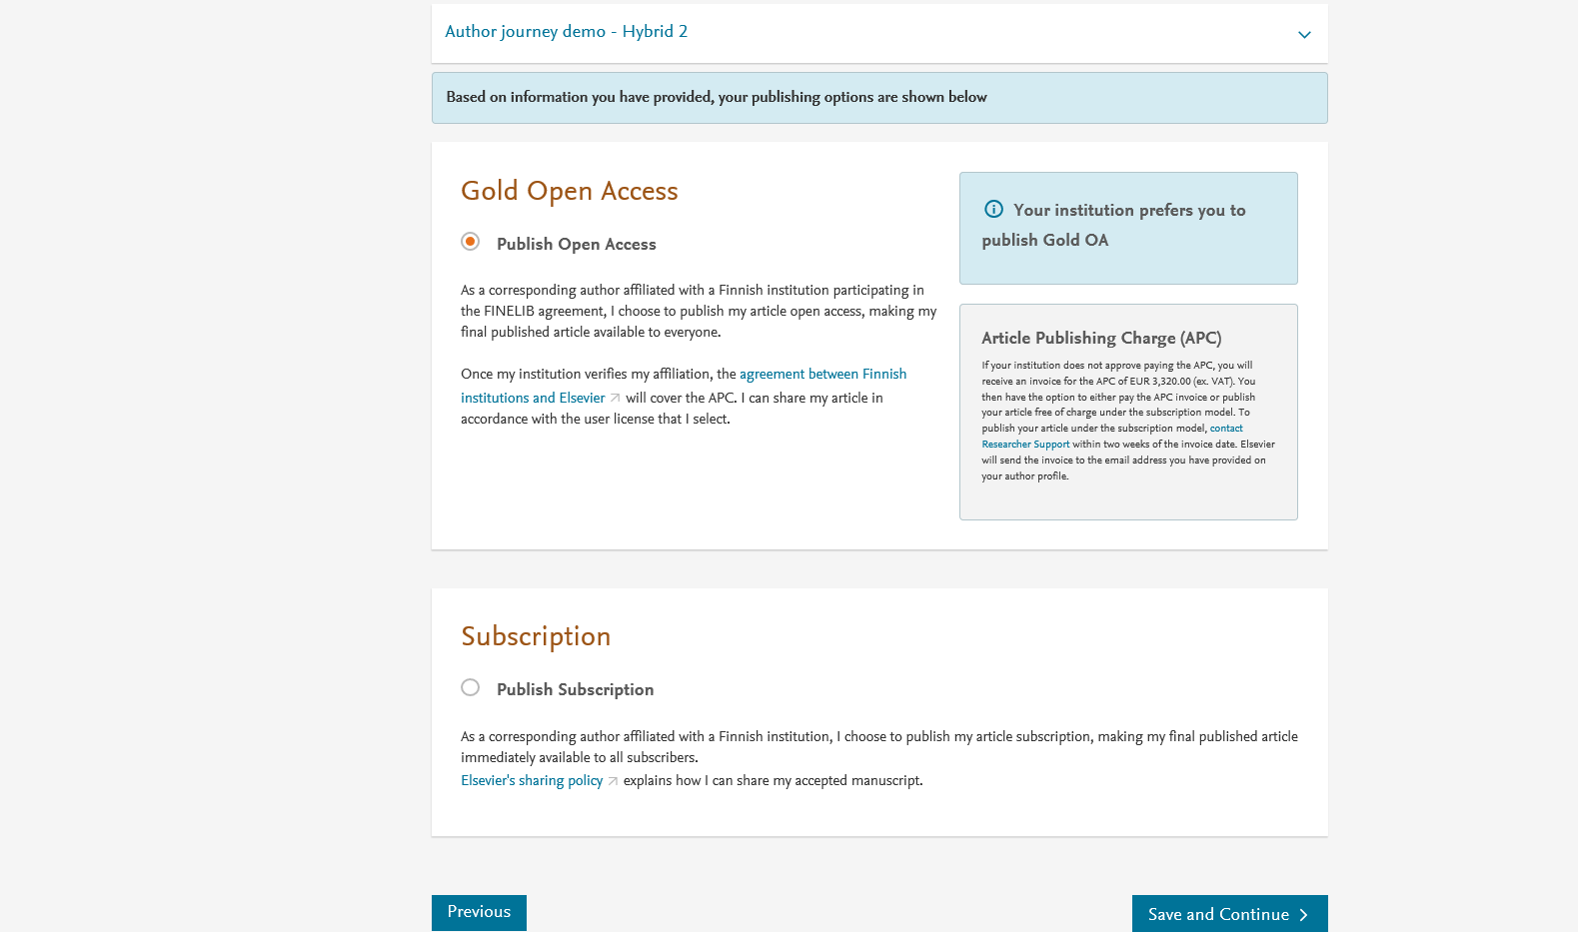
Based on the affiliation details, the author sees the Publishing Options. Gold OA option is followed by Subscription option and we inform the author that agreement covers the APC
If the librarian at the institution rejects the author request in the Elsevier Platform, we also make it clear that the authors will receive a full price invoice
Author selects OA

Slide 7
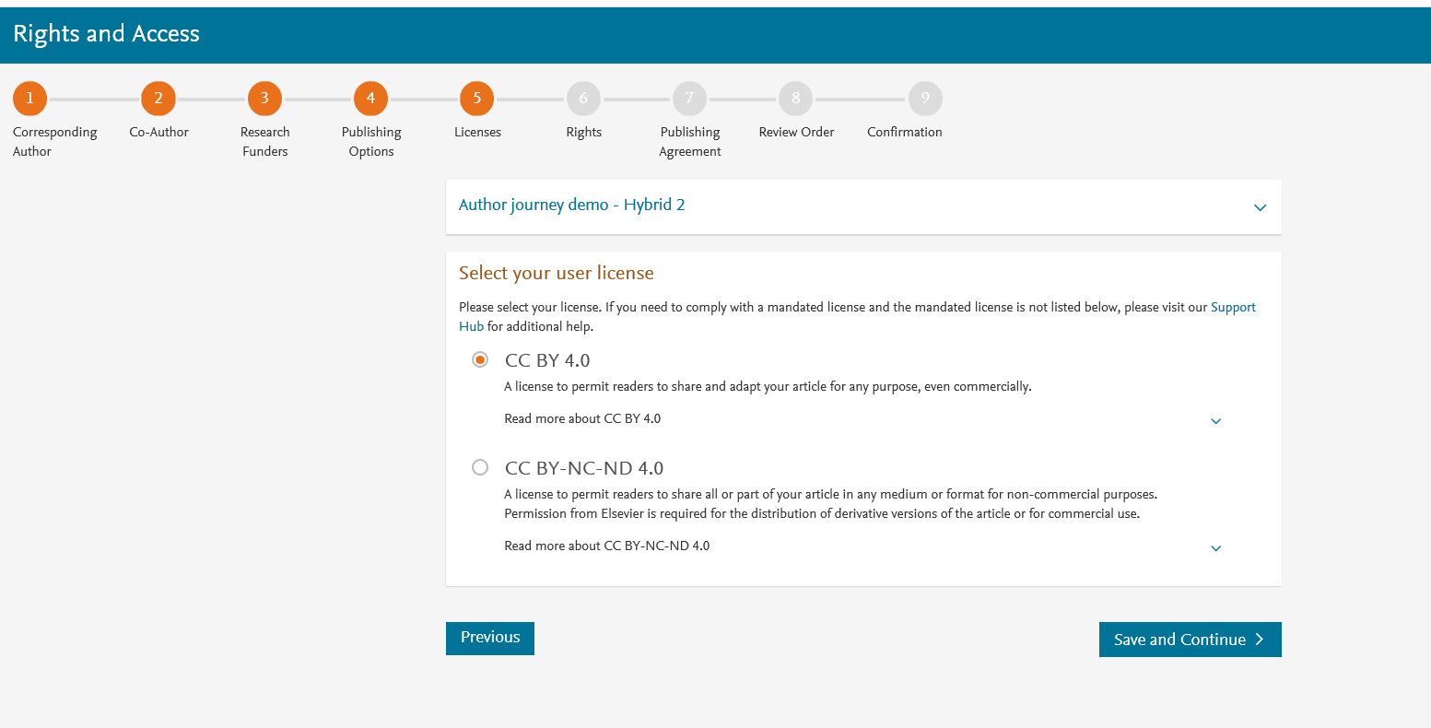
In case of OA, author selects the CC License

Slide 8
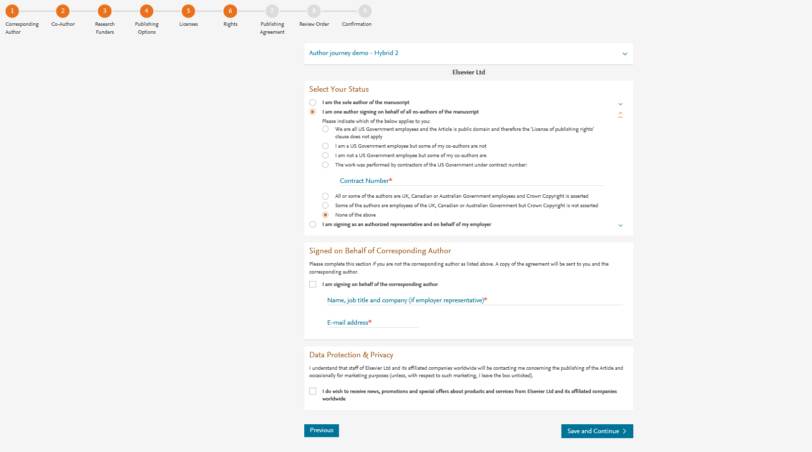
Author selects the rights

Slide 9
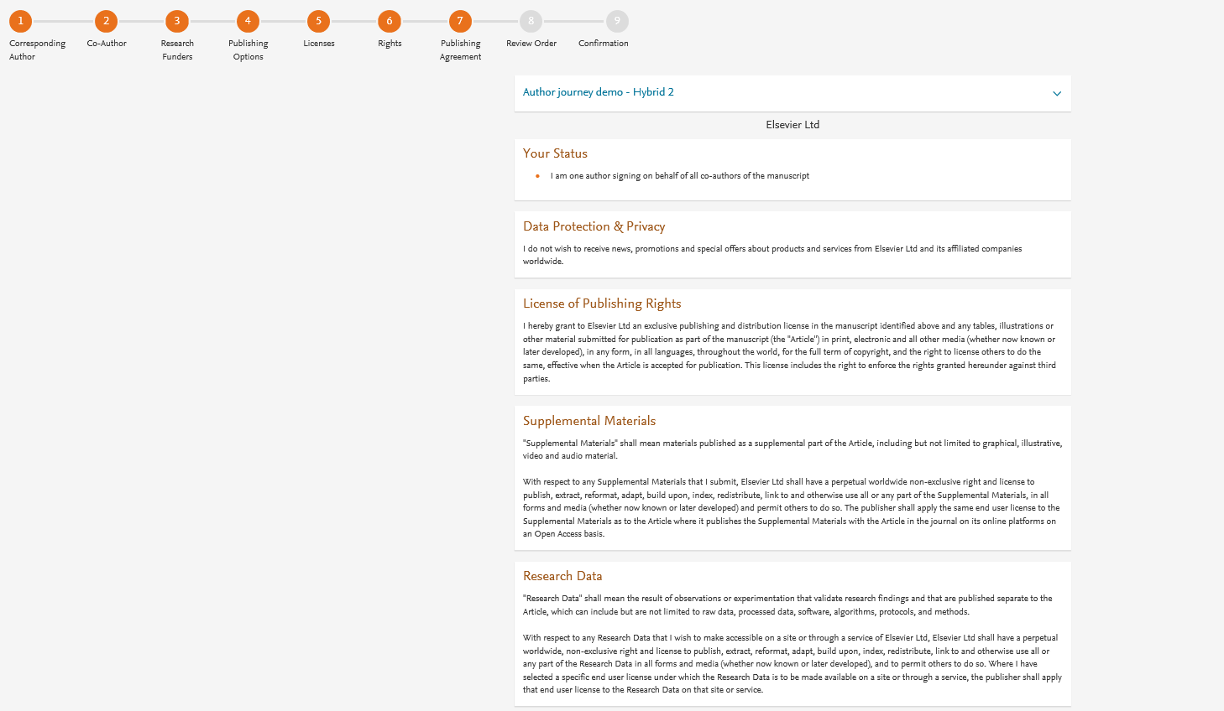
System presents author with the Journal License Publishing Agreement

Slide 10
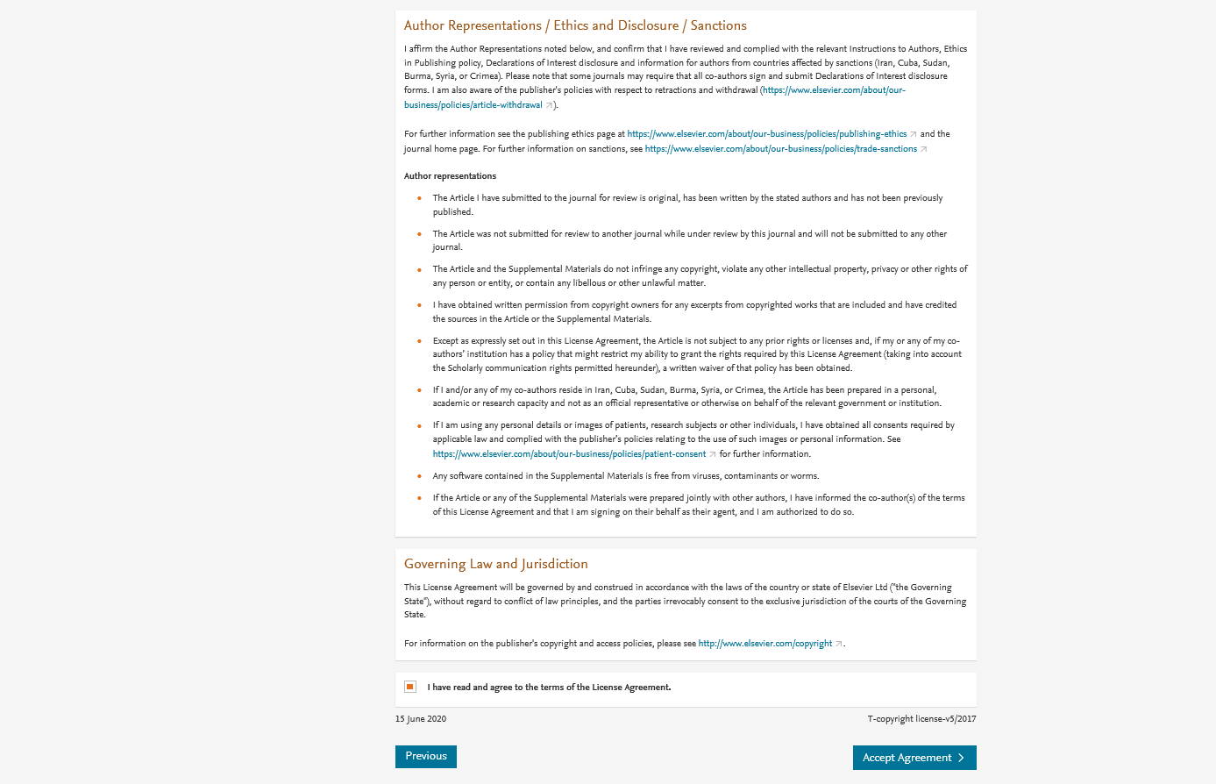
Authors agrees to the Journal License Publishing Agreement

Slide 11
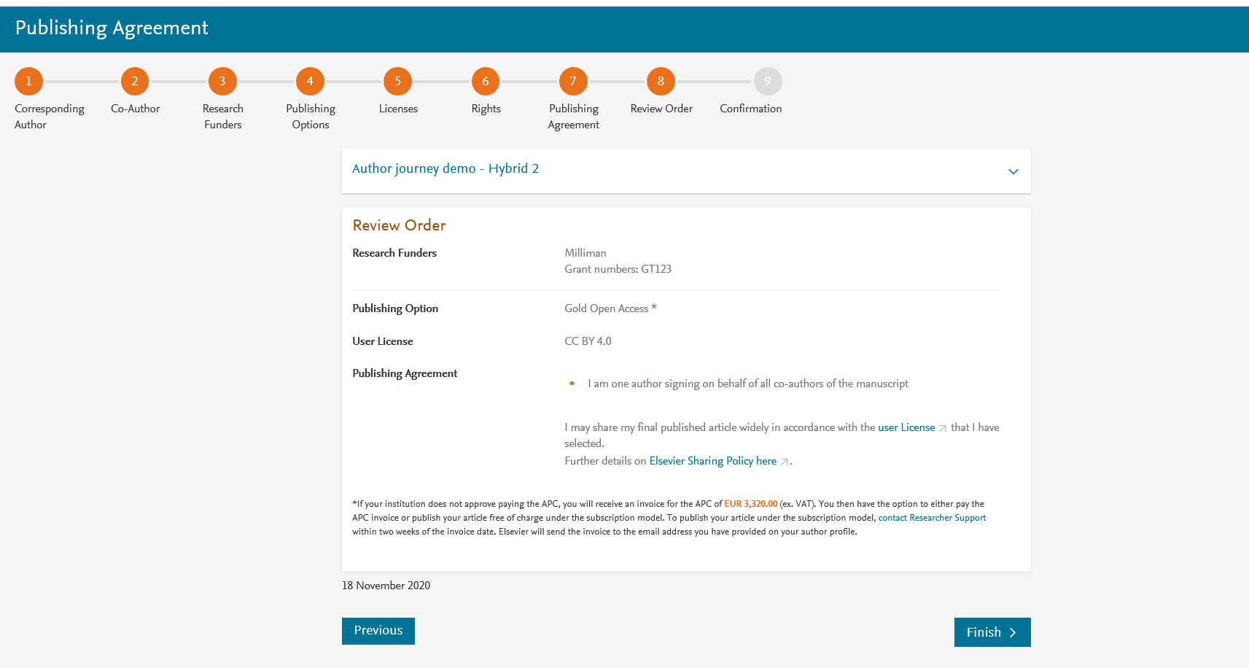
This is the summary page explaining the choices the author made in the publishing journey
Corresponding author and coauthors receive a copy of summary via email
Article becomes OA on ScienceDirect within 24 hours
Librarian receives a notification to validate the APC request within 48 hours

